Slide 1
Module 9
R Markdown

Slide 2
Contents
• Creating a R Markdown file
• Adding code chunks and text to an R Markdown file
• Code chunk and header options
Caching
Using Knit to output an R Markdown file

Slide 3
R Markdown
R Markdown is an authoring framework for data science that combines code, results, and commentary. Output formats include PDF, Word, HTML, slideshows, and more.
An R Markdown document essentially serves three purposes: communication, collaboration, and as a modern-day lab environment that captures not only what you did, but also what you were thinking.
From a communication perspective it enables decision makers to focus more on the results of your analysis rather than the code.
However, because it enables you to also include the code, it functions as a means of collaboration between data scientists.

Slide 4
R Markdown (cont…)
R Markdown uses the rmarkdown package, but you don’t have to explicitly load the package in RStudio.
RStudio will automatically load the package as needed.
The output format of an R Markdown file is a plain text file with an extension of Rmd.
These files contain a mixture of three types of content including a YAML header, R code, and text mixed with simple text formatting.
The output R markdown file contains both code and the output of the code.

Slide 5
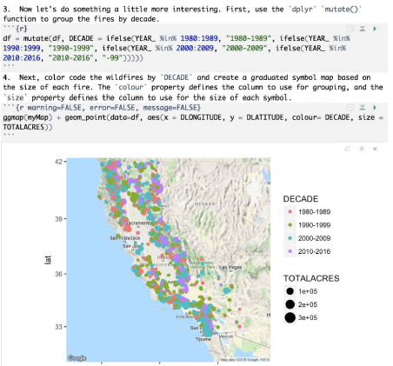
R Markdown (cont…)

Slide 6
R Markdown (cont…)
YAML (“Yet Another Markup Language” or “YAML Ain't Markup Language,” depending on who you ask) is the metadata that tells R Markdown, pandoc, and other software exactly how to process or display the document.
An R Markdown document ( *.Rmd ) is first compiled to Markdown ( *.md ) through the knitr package, and then Markdown is compiled to other output formats (such as LaTeX or HTML) through Pandoc. This process is automated by the rmarkdown package.
Pandoc is a free and open-source document converter, widely used as a writing tool (especially by scholars) and as a basis for publishing workflows.
https://pandoc.org/getting-started.html

Slide 7
R Markdown (cont…)
Using the RStudio interface you can run sections of the code or all the code in the file.
The code is enclosed by three back-ticks(``` ….. ```) followed by the output of the code below.
If you want to export the contents to a specific file type you can use the Knit functionality embedded in RStudio to export to HTML, PDF, and Word formats.
This will export a complete file containing text, code, and results.

Slide 8
Exercise 1: Creating an R Markdown file
An R Markdown file is simply a plain text file with a file extension of .Rmd. You can use RStudio to create new markdown files, which is what you’ll do in this brief exercise.
The exercises in this chapter require the following packages: readr, dplyr, ggplot2, and ggmap. They can be loaded from the Packages pane, the Console pane, or a script.
Open RStudio and go to File | New File | R Markdown. This will display the dialog you see below. There are different types of markdown that can be created, but for this exercise we’ll keep it simple and create a document.

Slide 9
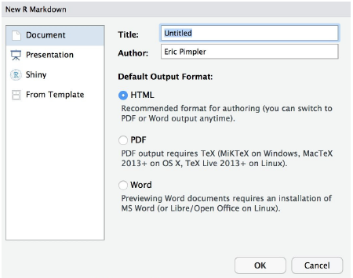
Exercise 1: Creating an R Markdown file (Cont…)

Slide 10
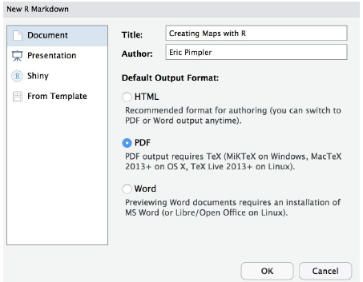
Exercise 1: Creating an R Markdown file (Cont…)
3. Select Document (which is the default), give it a title of Creating
Maps with R, change the author name if you’d like, and select PDF as
the output.

Slide 11
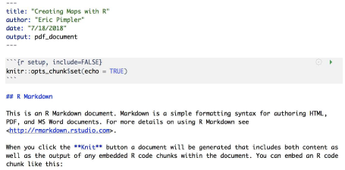
Exercise 1: Creating an R Markdown file (Cont…)
4. This will create a file with some header information, text, and code.
Your file should look similar to the screenshot below.

Slide 12
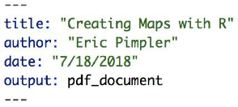

Exercise 1: Creating an R Markdown file (Cont…)
5. At the very top of the file is the header information, which is
surrounded by dashes. We’ll add some content to this section in a
later exercise, but for now we’ll leave it as is.
6. Code sections are grouped through the use of back-ticks as seen in the screenshot below.

Slide 13
Exercise 1: Creating an R Markdown file (Cont…)
7. Plain text and formatted text can be included in a markdown file as
well.
Text that needs to be formatted must follow a specific syntax. For example, you format text for italics, bold font, headings, links and images.
8. Other than the header information we aren’t going to use any of the
default code or text provided so go ahead and delete everything
other than the header.
9. Save the file to your working directory with a name of
CreatingMapsWithR.Rmd.

Slide 14
Adding Code Chunks and Text to an R Markdown
R code can be included in the R Markdown file through the use of chunks, which are defined through the use of three back-ticks followed by an r enclosed within curly braces.
Inside the curly braces are options that can be included.
These options can include TRUE | FALSE parameters for turning various types of messaging on and off.
Chunks define a single task, sort of like a function.

Slide 15
Adding Code Chunks and Text to an R Markdown
They should be selfcontained and tightly defined pieces of code.
There are three ways to insert chunks into an R Markdown file: Cmd/Ctrl-Alt-I, the Insert button on the editor toolbar, and by manually typing the chunk delimiters.
You can also add plain text and formatted text to an R Markdown file.
Formatted text has to be defined according to a specific syntax.

Slide 16
Exercise 2:
##Step 1: Creating a Basemap.
First, add some descriptive text that will be included in the output R Markup file.
Notice that the text Step 1: Creating a Basemap has been preceded by two pound signs.
The pound signs are used to define headings. In this case two pound signs would translate to an HTML <h2> tag, which simply defines the size of the text.
Also notice that some of the words like ggmap and ggplot are surrounded by single quotes.
Single quotes are used to define a different style for the word that indicates this word is programmatic code.

Slide 17
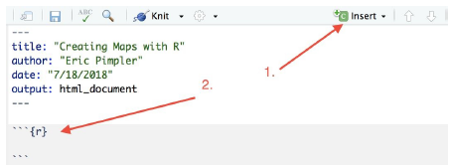
Exercise 2:
1.1. First, load the needed libraries
1.2. Click Insert and then R to insert a new code chunk as seen below.
The code you add will go in between the set of back-ticks. There can be number of code chunks, with each defining a specific task. They are similar in many ways to functions.

Slide 18
Exercise 2:
1.3. For this code chunk we’ll just load the libraries that will be used in
this exercise.
Add the code you see below inside the code chunk boundaries.
```{r}
library(ggplot2) library(ggmap) library(readr) library(dplyr) ```
1.4. Add some additional text that describes the next step.

Slide 19
Exercise 2 (Cont….)
2. Create a variable called `myLocation` and set it to `California`.
Call the `get_map()` function with a zoom level of 6, and plot the map using the `ggmap()` function, passing in a reference to the variable returned by the `get_map()` function. The default map type is Google Maps with a style of Terrain.
2.1. Insert a new code chunk just below the descriptive text and add the
following code.
```{r}
myLocation <- "California”
myMap <- get_map(location = myLocation, zoom = 6) ggmap(myMap)

Slide 20
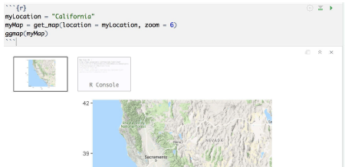
Exercise 2 (Cont….)
2.2. Let’s run the code that has been added so far to see the result.
Select Run | Run All from the RStudio interface.
The output is included inside the markdown document. If not, check your code and try running it again.

Slide 21
Exercise 2 (Cont….)
3. The code you see below will create a Google satellite basemap layer.
Other basemap layers include Stamen, OSM, and CloudMade.
3.1. Create a new code chunk and add the code you see below.
```{r}
myMap <- get_map(location = myLocation, zoom = 6, source=”google”,
maptype=”satellite”)

Slide 22
Exercise 2 (Cont….)
4. There are a number of ways that you can define the input location:
longitude/latitude coordinate pair, a character string, or a bounding
box.
When a character string is passed to the location parameter it is then passed to the geocoding service to obtain the latitude/ longitude coordinate pair.
4.1. Create a new code chunk and add the code you see below.
```{r}
myMap <- get_map(location = “Grand Canyon, Arizona”, zoom = 11)
ggmap(myMap)

Slide 23
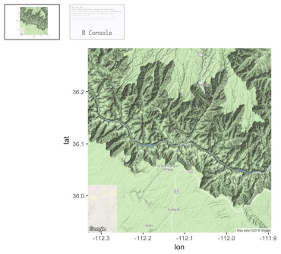
Exercise 2 (Cont….)
4.2. Let’s stop adding code for now and run what is currently in the file
to see the result. Select Run | Run All.

Slide 24
Exercise 2 (Cont….)
##Step 2: Adding Operational Data Layers
`ggmap()` returns a `ggplot` object, meaning that it acts as a base layer in the `ggplot2` framework. This allows for the full range of `ggplot2` capabilities meaning that you can plot points on the map, add contours and 2D heat maps, and more.
For this section we’ll use the historical wildfire information found in the StudyArea_SmallFile.csv file. Load this dataset using the `read_csv()` function.
1.1. Create a new code chunk and add the code you see below. This will
load wildfire data from a csv file. Note: The path to your
StudyArea_SmallFile. csv

Slide 25
Exercise 2 (Cont….)
Note: The path to your StudyArea_SmallFile. Csv file may differ from the one you see below
```{r}
dfWildfires <- read_csv("~/Desktop/IntroR/Data/StudyArea_SmallFile. Csv", col_types = list(FIRENUMBER = col_character(), UNIT = col_ character()), col_names = TRUE)
```

Slide 26
Exercise 2 (Cont….)
2. Initially just load the wildfire events as points. Add the code you
see below to produce a map of California that displays wildfires from
the years 1980-2016 that burned more than 1,000 acres.
2.1. Create a new code chunk and add the code you see below. This code chunk will display each of the wildfires as a point on the map.
```{r}
myLocation <- ‘California’
#get the basemap
myMap <- get_map(location = myLocation, zoom = 6)

Slide 27
Exercise 2 (Cont….)
# use the select() function to limit the columns from the data frame
df <- select(dfWildfires, STATE, YEAR_, TOTALACRES, DLATITUDE,
DLONGITUDE)
#use the filter() function to get only fires in California with acres
#burned greater than 1000
df <- filter(df, TOTALACRES >= 1000 & STATE == ‘California’)
#produce the final map
ggmap(myMap) + geom_point(data=df, aes(x = DLONGITUDE, y =
DLATITUDE))
```

Slide 28
Exercise 2 (Cont….)
3. Now let’s do something a little more interesting. First, use the `dplyr`
`mutate()` function to group the fires by decade.
3.1. Create a new code chunk and add the code you see below.
The mutate() function is used in this code chunk to create a new column called DECADE and then populate each row with a value for the decade in which the fire occurred.
```{r}
1989”, ifelse(YEAR_ %in% 1990:1999, "1990-1999", ifelse(YEAR_ %in%
2000:2009, "2000-2009", ifelse(YEAR_ %in% 2010:2016, "2010-2016",
"-99")))))
```

Slide 29
Exercise 2 (Cont….)
4. Next, color code the wildfires by `DECADE` and create a graduated
symbol map based on the size of each fire. The `colour` property
defines the column to use for grouping, and the `size` property
defines the column to use for the size of each symbol.
4.1. Create a new code chunk and add the code you see below. This
code chunk will color code the fires by decade.
```{r}
ggmap(myMap) + geom_point(data=df, aes(x = DLONGITUDE, y =
DLATITUDE, colour= DECADE, size = TOTALACRES))

Slide 30
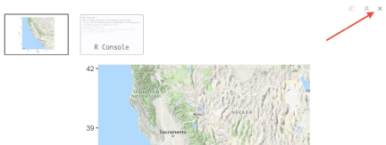
Exercise 2 (Cont….)
Let’s stop adding code for now and run what is currently in the file to see the result. Before running the code again go ahead and clear the past results by clicking the small X in the upper right hands corner of the output for each map as seen in the screenshot below.

Slide 31
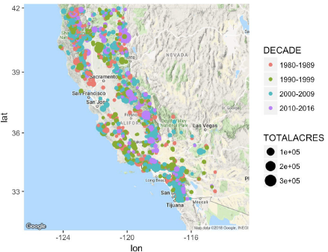
Exercise 2 (Cont….)
Select Run | Run All. The output produced will include several maps with the final map appearing as seen in the screenshot below.

Slide 32
Exercise 2 (Cont….)
5. Let’s change the map view to focus more on southern California, and
in particular the area just north of Los Angeles.
5.1 Create a new code chunk and add the code you see below. This
code chunk will color code the fires by decade and size the symbols
according the total acreage burned.
```{r}
myMap <- get_map(location = “Santa Clarita, California”, zoom = 10)
ggmap(myMap) + geom_point(data=df, aes(x = DLONGITUDE, y =
DLATITUDE, colour= DECADE, size = TOTALACRES))
```

Slide 33
Exercise 2 (Cont….)
6. Next we’ll add contour and heat layers.
The `geom_density2d()` function is used to create the contours while the `stat_ density2d()` function creates the heat map.
You can experiment with the colors using the `scale_fill_gradient(low and high)` properties. Here we’ve set them to green and red respectively, but you may want to change the color scheme.
6.1 Create a new code chunk and add the code you see below. This code chunk will create a heat map and add contours.
```{r}
myMap <- get_map(location = “Santa Clarita, California”, zoom = 8)

Slide 34
Exercise 2 (Cont….)
7. If you’d prefer to see the heat map without contours, the code can be
simplified as follows:
7.1. Create a new code chunk and add the code you see below. This
code chunk will remove the contours.
```{r}
ggmap(myMap, extent = "device ") + stat_density2d(data = df, aes(x =
DLONGITUDE, y = DLATITUDE, fill = ..level.., alpha = ..level..), size =
0.01,bins = 16, geom = " polygon ") + scale_fill_gradient(low = " green ", high = " red ") + scale_alpha(range = c(0, 0.3), guide = FALSE)
```

Slide 35
Exercise 2 (Cont….)
8. Finally, let’s create a facet map that depicts hot spots for each year in
the current decade.
The dataset contains information up through the year 2016.
8.1. Create a code chunk and add the code you see below.
```{r}
df <- filter(dfWildfires, STATE == ‘California’)
df <- filter(df, YEAR_ %in% c(2010, 2011, 2012, 2013, 2014, 2015, 2016))
myMap <- get_map(location = “Santa Clarita, California”, zoom = 9)

Slide 36
Exercise 2 (Cont….)
ggmap(myMap, extent = "device ") + stat_density2d(data = df, aes(x =
DLONGITUDE, y = DLATITUDE, fill = ..level.., alpha = ..level..), size =
0.01,bins = 16, geom = " polygon ") + scale_fill_gradient(low = " green ", high = " red ") + scale_alpha(range = c(0, 0.3), guide = FALSE) + facet_wrap(~ YEAR_)
That completes the code for this R Markdown file. Go ahead and run the code again to see the final output by selecting Run | Run All.

Slide 37
Code chunk and header options
Chunk options are arguments supplied to the chunk header. Currently there are approximately 60 such options. We’ll examine some of the more commonly used and important options in this exercise. All code chunk options are placed inside the {r} block.
Code chunks can be given an optional name as seen in the example code below where the code chunk has been given a name of MapSetup
.
```{r MapSetup, warning=FALSE, error=FALSE, message=FALSE}

Slide 38
Code chunk and header options
The advantages of naming chunks include
easier navigation using the code navigator in RStudio,
useful names given to graphics produced by chunks, and
the ability to cache chunks to avoid re-performing computations on each run.
This last advantage is perhaps the most useful.
Exercise 3:
The R Markdown pane includes a quick access menu for easily navigating to different sections of your R Markdown page. The arrow in the screenshot below displays the location of this functionality.

Slide 39
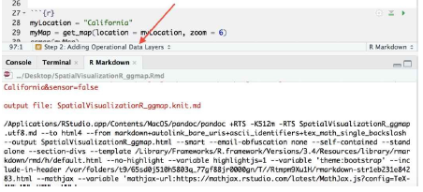
Exercise 3 (Cont….)

Slide 40
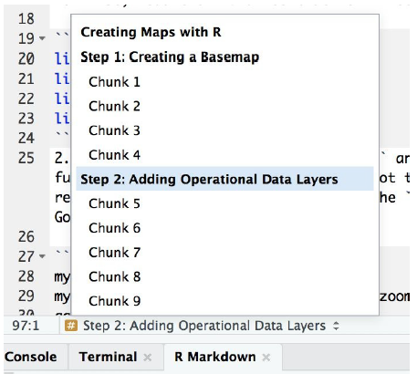
Exercise 3 (Cont….)
Click on the quick access button now to see the different sections of the R Markdown file.
You’ll notice that it is sectioned by headings and then code chunks. To make navigation easier you can name each of these chunks.

Slide 41
Exercise 3 (Cont….)
Select Chunk 1 under Step 1: Creating a Basemap to return to the first code chunk you created in an earlier exercise.
This code chunk simply defines the libraries that will be used in the file. In the {r} section of the header name the chunk libs.
```{r libs}
Notice that the value has now been updated in the quick access dropdown menu.

Slide 42
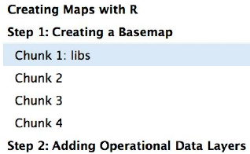
Exercise 3 (Cont….)
4. Rename the rest of your code chunks. You can use whatever name
makes the most sense for each.
Next, we’ll add some code options. Although there are currently 60+ options that can be applied to a code chunk we’ll examine only a few of the more important options. You can get a list of all the available code chunk options at
https://www.rstudio.com/wp-content/uploads/2015/03/ rmarkdownreference.pdf.

Slide 43
Exercise 3 (Cont….)
Messaging is one of the most commonly used and useful options.
There are actually three messaging options: messages, warnings, errors. All three are TRUE | FALSE values that can be set and all are set to FALSE by default.
Navigate to Chunk 2 and add the options you see highlighted below. This will turn on the messaging for any general information messages, warnings, and errors.
```{r error=TRUE, warning=TRUE, message=TRUE}
myLocation <- “California”
myMap <- get_map(location = myLocation, zoom = 6)
ggmap(myMap)
```

Slide 44
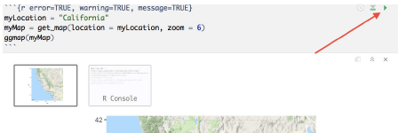
Exercise 3 (Cont….)
Now when you run this section any of these messages will be printed out along with the output. Rather than running the entire markdown file code each time you want to test something you can limit the run to a particular code chunk by clicking the arrow on the far-right hand side of the code chunk as seen in the screenshot below.

Slide 45
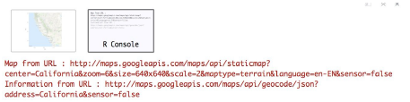
Exercise 3 (Cont….)
Clicking the R Console window should produce an output similar to the screenshot below.

Slide 46
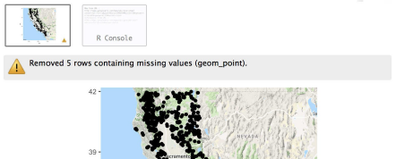
Exercise 3 (Cont….)
Now add the same message, warning, and error options to your other code chunks.
Run the code chunks one at a time an examine the output. Any warning and errors will be prominently displayed as seen in the screenshot below.

Slide 47
Exercise 3 (Cont….)
You can also define document wide options as well. In this step we’ll look at a common option defined in the header. The content of the header defines parameters that control various settings for the entire document.
The header can include basic descriptive information including the title, author, date, and output format along with other settings including parameters and bibliographies and citations.
Parameters are used when you need to re-render the same report but with distinct values for inputs.
The params field controls these parameters.

Slide 48
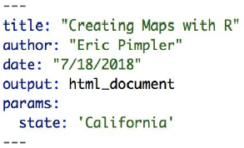
Exercise 3 (Cont….)
You’ll notice in the code example below that a state parameter has been defined with a value of California.
This value can then be accessed elsewhere in the R Markdown file using the syntax params$<parameter> or params$state in this example.

Slide 49
Exercise 3 (Cont….)
12. Navigate to Chunk 2 and find the line you see below.
myLocation <- "California“
13. Change this line as seen below to access the state parameter.
```{r error=TRUE, warning=TRUE, message=TRUE}
myLocation <- params$state
myMap <- get_map(location = myLocation, zoom = 6) ggmap(myMap)
```

Slide 50
Exercise 3 (Cont….)
Run the code for Chunk 2 only and you should see the same output map centered on California.
Clear the output for chunk 2 by clicking the X in the upper right-hand corner of the output.
Return to the state parameter in the header and change the value to Montana.
title: “Creating Maps with R”
author: “Eric Pimpler”
date: “7/18/2018”
output: html_document
params:
state: ‘Montana’

Slide 51
Caching
Code chunks can also be cached, which is great for computation that takes a long time to execute.
To enable caching the cache parameter should be set to TRUE.
This will save the output of the code chunk to a specially named file on desk.
On any subsequent runs, knitr checks to see if the code has changed, and if not, it will reuse the cached results.
You do need to be careful with caching though as it will only re-run a code chunk if the code changes. However, it doesn’t take into account things such as changes to underlying data sources.

Slide 52
Exercise 4
Find the code chunk you see below that maps the individual wildfire points.
You may have named the chunk something other than what I have named the chunk (point_map).
```{r point_map, error=TRUE, warning=TRUE, message=TRUE} myLocation <- ‘California’
#get the basemap
myMap <- get_map(location = myLocation, zoom = 6)
# use the select() function to limit the columns from the data frame
df <- select(dfWildfires, STATE, YEAR_, TOTALACRES, DLATITUDE, DLONGITUDE)

Slide 53
Exercise 4
#use the filter() function to get only fires in California with acres
#burned greater than 1000
df <- filter(df, TOTALACRES >= 1000 & STATE == ‘California’)
#produce the final map
ggmap(myMap) + geom_point(data=df, aes(x = DLONGITUDE, y =
DLATITUDE))
```

Slide 54
Exercise 4
2. Add the cache parameter to the options for the chunk as seen below.
```{r point_map, cache=TRUE, error=TRUE, warning=TRUE,
This code chunk is dependent upon the data in the dfWildfires data frame, which is loaded in the code chunk directly preceding this chunk.
The code chunk that loads the data from a csv file into the dfWidlfires variable can be seenbelow. You may have named the chunk differently (load_data).
```{r load_data, error=TRUE, warning=TRUE, message=TRUE} dfWildfires <- read_csv(“~/Desktop/IntroR/Data/StudyArea_SmallFile. csv”, col_types = list(FIRENUMBER = col_character(), UNIT = col_ character()), col_names = TRUE) ```

Slide 55
Exercise 4 (Cont…)
Because the point_map code chunk is dependent upon the data in the dfWildfires data frame you need to add a dependson parameter to the point_map code chunk.
```{r point_map, cache=TRUE, dependson=’load_data’, error=TRUE, warning=TRUE, message=TRUE}
This will cover situations where the read_csv() call changes.
For example, a different file might be read by the function.

Slide 56
Exercise 4 (Cont…)
Keep in mind that the cache and dependson parameters only monitor for changes in the .Rmd file.
What would happen if the underlying data in the StudyArea_SmallFile.csv file changes?
The answer is that the changes wouldn’t be picked up.
To handle this sort of situation you can use the cache.extra option along with the file.info() function.
```{r load_data, cache.extra = file.info(‘~/Desktop/IntroR/
Data/StudyArea_SmallFile.csv’) error=TRUE, warning=TRUE,

Slide 57
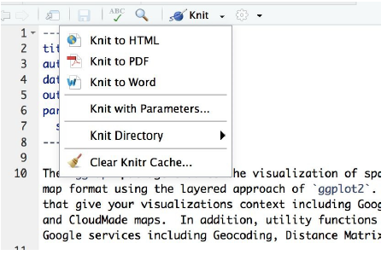
Exercise 5: Using Knit to output an R markdown file
The Knit functionality built into RStudio can be used to export an R Markdown file to various formats including HTML, PDF, and Word.
Knit can be accessed from the dropdown menu seen in the screenshot below.

Slide 58
Exercise 5:
To simplify the output of the R Markdown file you’re going to remove some of the options that were added in previous exercise. In the CreateMapsWithR.rmd file remove cache, depends on, and cache. Extra parameters added in the last exercise.
Select Knit and find the Knit Directory menu item from the RStudio interface. By default, it is set to Document Directory. This simply means that the output file will go into the same directory where the R Markdown file has been saved.

Slide 59
Exercise 5 (Cont…)
Select Knit | Knit to HTML. Knit will begin processing the file and you’ll see output messaging information written to the Console pane.
If everything goes as expected an output HTML file called CreatingMapsWithR.html will be created in the same folder where the CreatingMapsWithR.Rmd file was saved.
The output file will be fairly length, but the top part should look similar to the screenshot below.

Slide 60
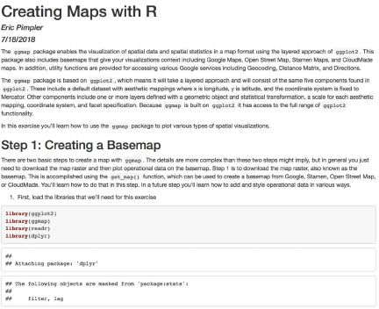
Exercise 5 (Cont…)

